Slide 1
Policy Tools for Broadband Subsidy programs: spatial regression discontinuity designs and Bayesian Wombling.
Aritra Halder*, Joshua R. Goldstein*, Hannah Charankevich*, Neil Kattampallil*,
Aaron Schroeder*, John Pender**, Stephanie S. Shipp* and Sallie Keller*
*Social and Decision Analytics Division (UVA-SDAD),
**Economic Research Service-U.S. Dept. of Agriculture.
Federal Committee on Statistical Methodology (virtual)
November 2-4, 2021
The findings and conclusions in this presentation are those of the authors and should not be construed to represent any official USDA or U.S. Government determination or policy. This research was supported by the U.S. Department of Agriculture, Economic Research Service under Cooperative Agreement #58-6000-8-0039.

Slide 2
Motivation
Broadband investment is a high priority for the Administration and Congress
Current pandemic highlights the importance of broadband
Economic impacts of broadband programs are studied by only a few researchers
The Broadband Initiatives Program (BIP), enacted as part of the American Recovery and Reinvestment Act in 2009, is the largest rural broadband program to date – with an appropriation of $2.5 billion.
The study's purpose is to devise a novel statistical methodology to evaluate BIP.
Notes:
* $1.8 billion in funding in FY 2018 – 2020 for rural broadband through new ReConnect Program. Several other USDA and FCC programs also promote broadband
* Kandilov and coauthors investigated impacts of the Farm Bill Broadband Loan (FBBL) program on various economic outcomes prior to 2010 in several papers (Kandilov and Renkow 2010; Kandilov et al. 2017; Kandilov and Renkow 2020). Kandilov & Renkow (2020) also examined impacts of the Community Connect Grant program prior to 2010.
* Dinterman and Renkow (2017) investigated impacts of the FBBL program on number of broadband providers, also prior to 2010

Slide 3
Data Sources and Methods
Identify data sources that reflect effect of broadband
CoreLogic: Property Values and Housing Characteristics
American Community Survey (ACS): Demographic variables
RUS Program boundary and associated shapefiles
Develop methodology for the comparison of home prices for properties within and outside of RUS program boundaries
Model the house prices using an approximate hierarchical Bayesian spatial model (Datta et. al. 2016, Rue et. al. 2009)
Featuring an off-the-shelf difference-in-difference estimator
Perform posterior surface analysis to study impacts using
Regression Discontinuity Analysis
Gradient Assessment termed as “Wombling” (Womble 1996)
Notes:
Datta, Abhirup, et al. "Hierarchical nearest-neighbor Gaussian process models for large geostatistical datasets." Journal of the American Statistical Association 111.514 (2016): 800-812.
Rue, Håvard, Sara Martino, and Nicolas Chopin. "Approximate Bayesian inference for latent Gaussian models by using integrated nested Laplace approximations." Journal of the royal statistical society: Series b (statistical methodology) 71.2 (2009): 319-392.
Womble, William H. "Differential systematics." Science 114.2961 (1951): 315-322.

Slide 4
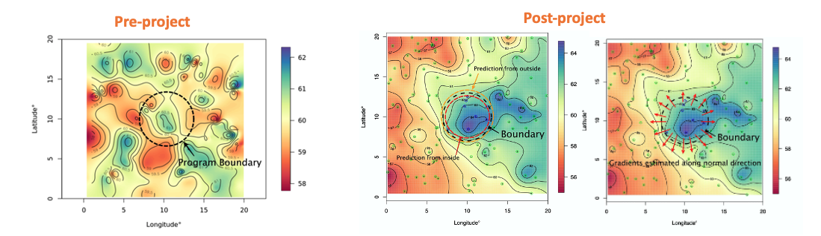
Rationale
We compare the estimated spatial surface for house prices across the program boundary before and after program implementation.
A steep gradient or sharp discontinuity in the surface is evidence of rapid change in house prices at the RUS boundary.

Slide 5
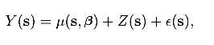
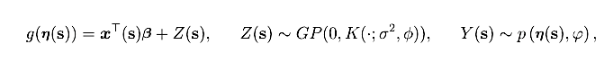
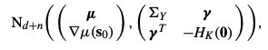
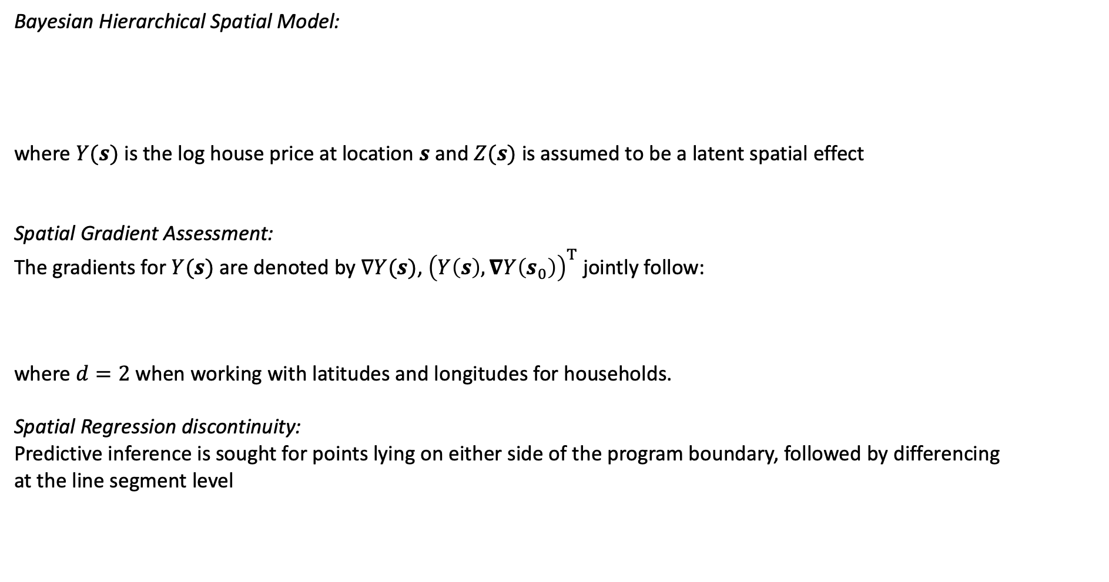
Theoretical Setup
Bayesian Hierarchical Spatial Model:
where $Y(s)$ is the log house price at location $s$ and $Z(s)$ is assumed to be a latent spatial effect
Spatial Gradient Assessment:
The gradients for $Y(s)$ are denoted by $∇Y(s)$, ${\left(Y\left(s\right),∇Y\left(s_{0}\right)\right)}^{T}$ jointly follow:
where $d=2$ when working with latitudes and longitudes for households.
Spatial Regression discontinuity:
Predictive inference is sought for points lying on either side of the program boundary, followed by differencing
at the line segment level
Notes:
following an approximate
spatial process whose variability is governed by the covariance matrix $K$ which is a function of inter-site Euclidean
Distance $Δ=|\left|s−s^{′}\right||$ between locations $s$ and $s′$.

Slide 6
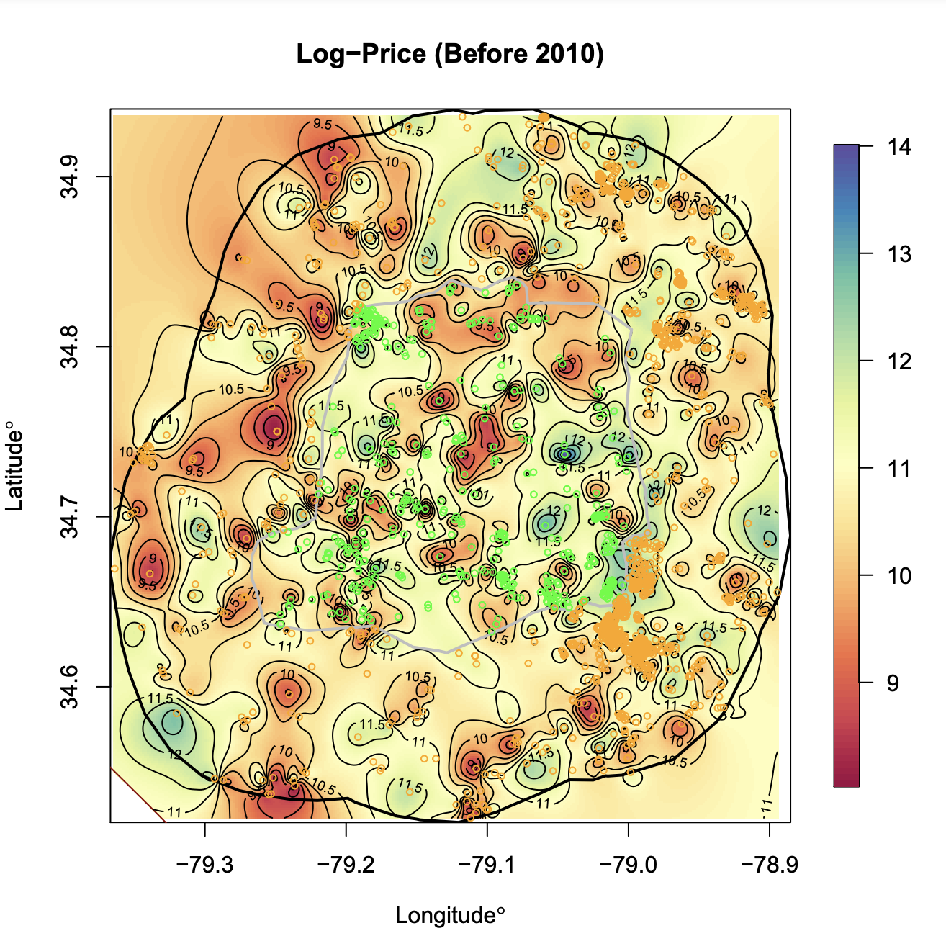
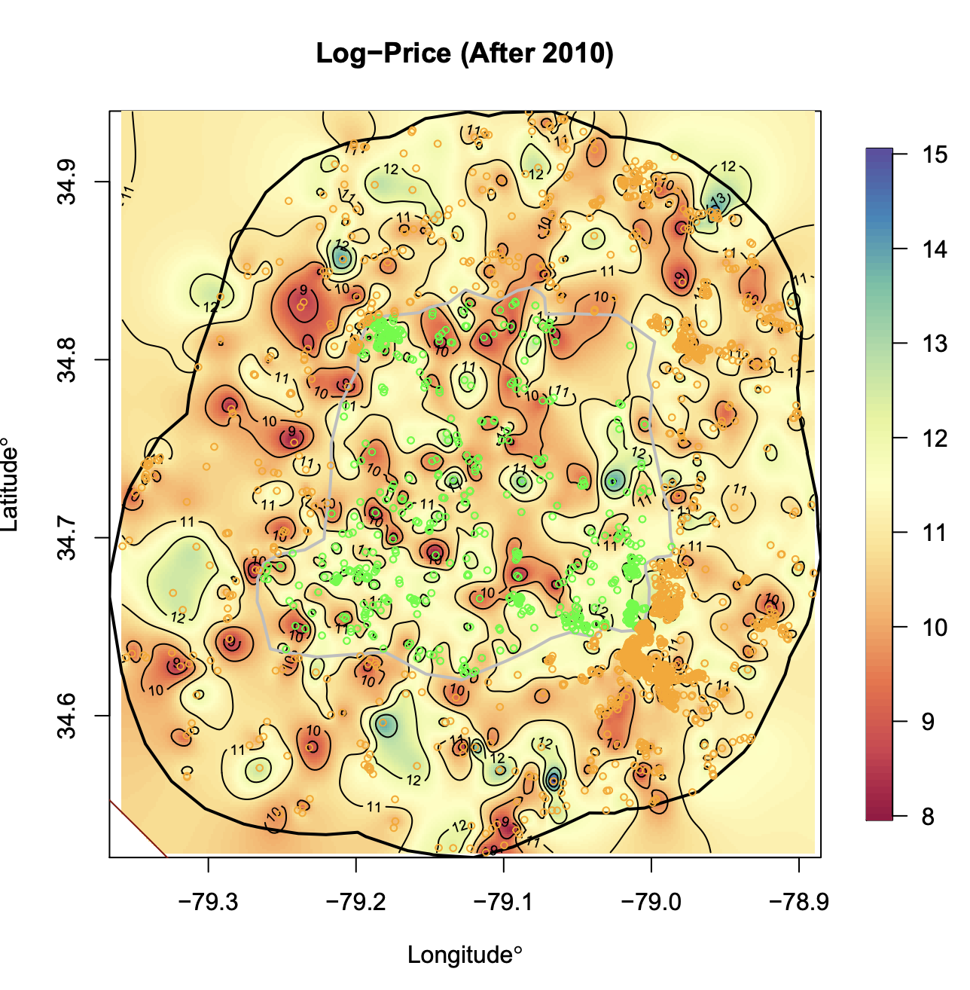
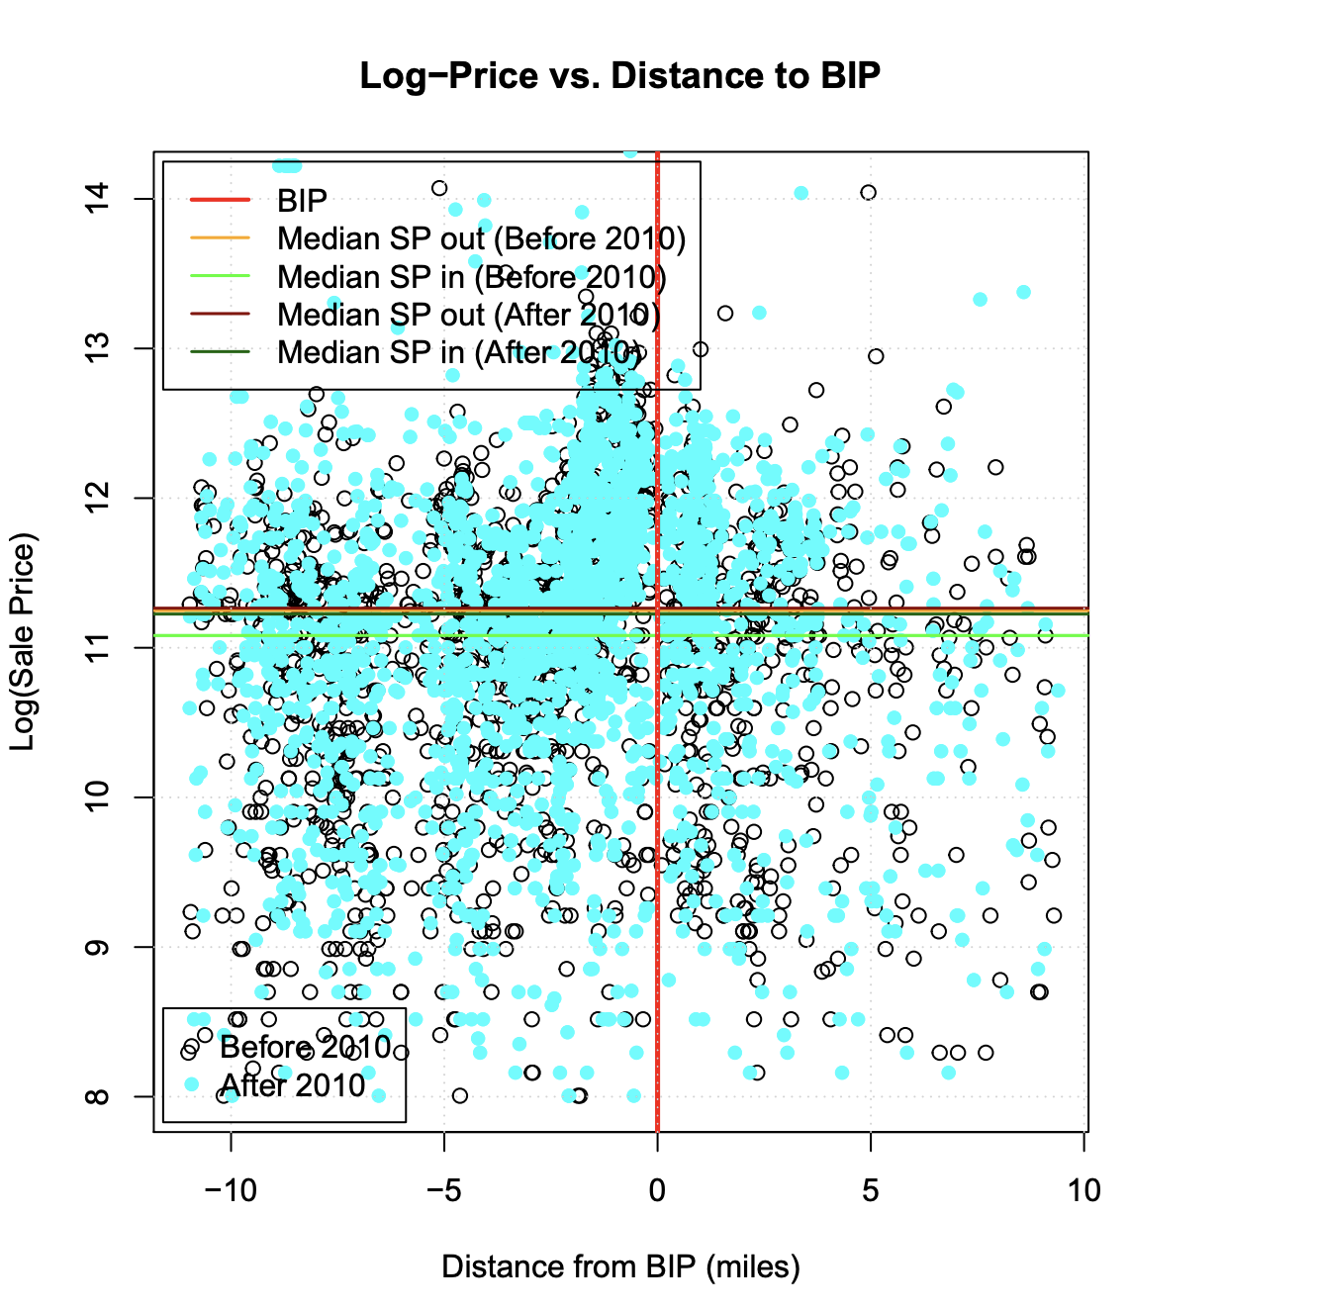
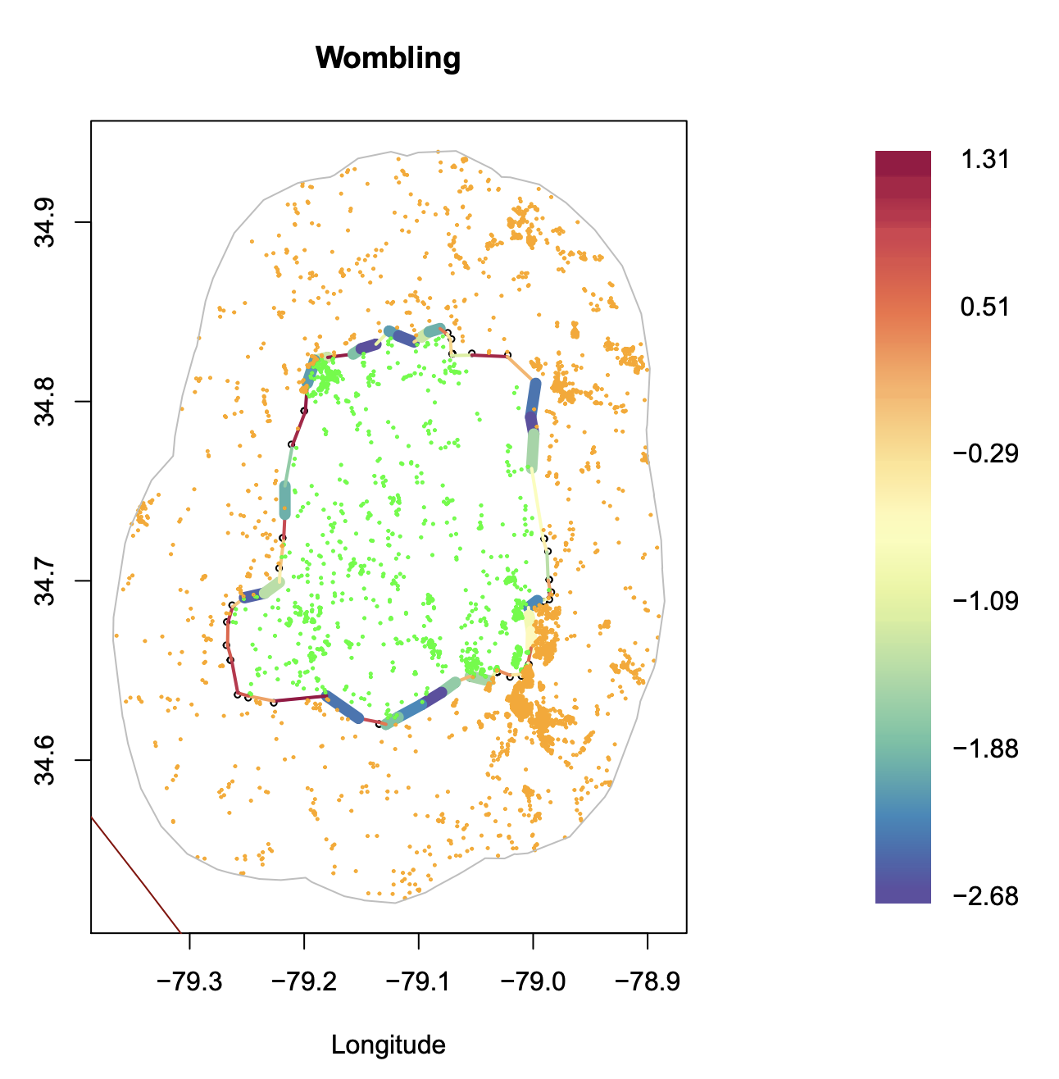
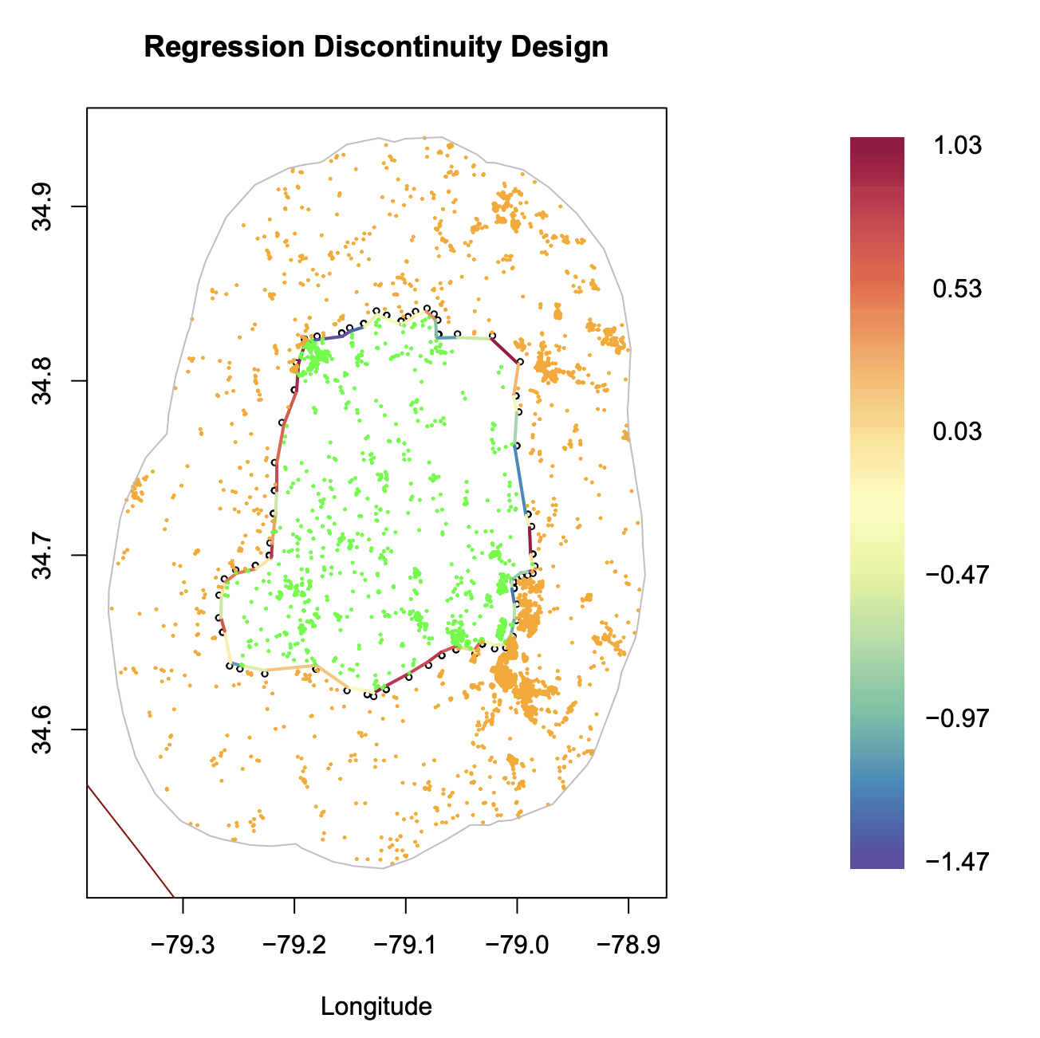
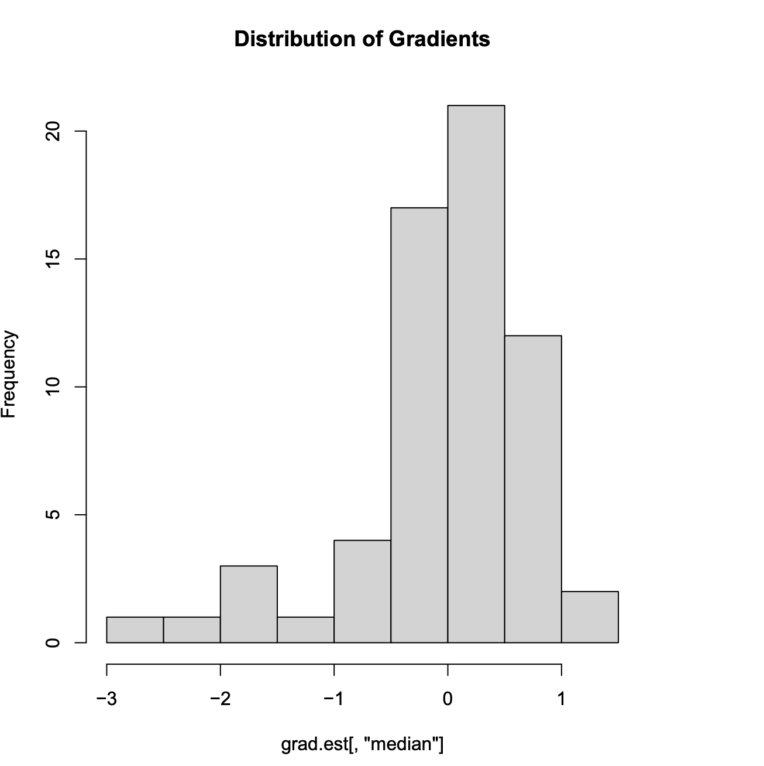
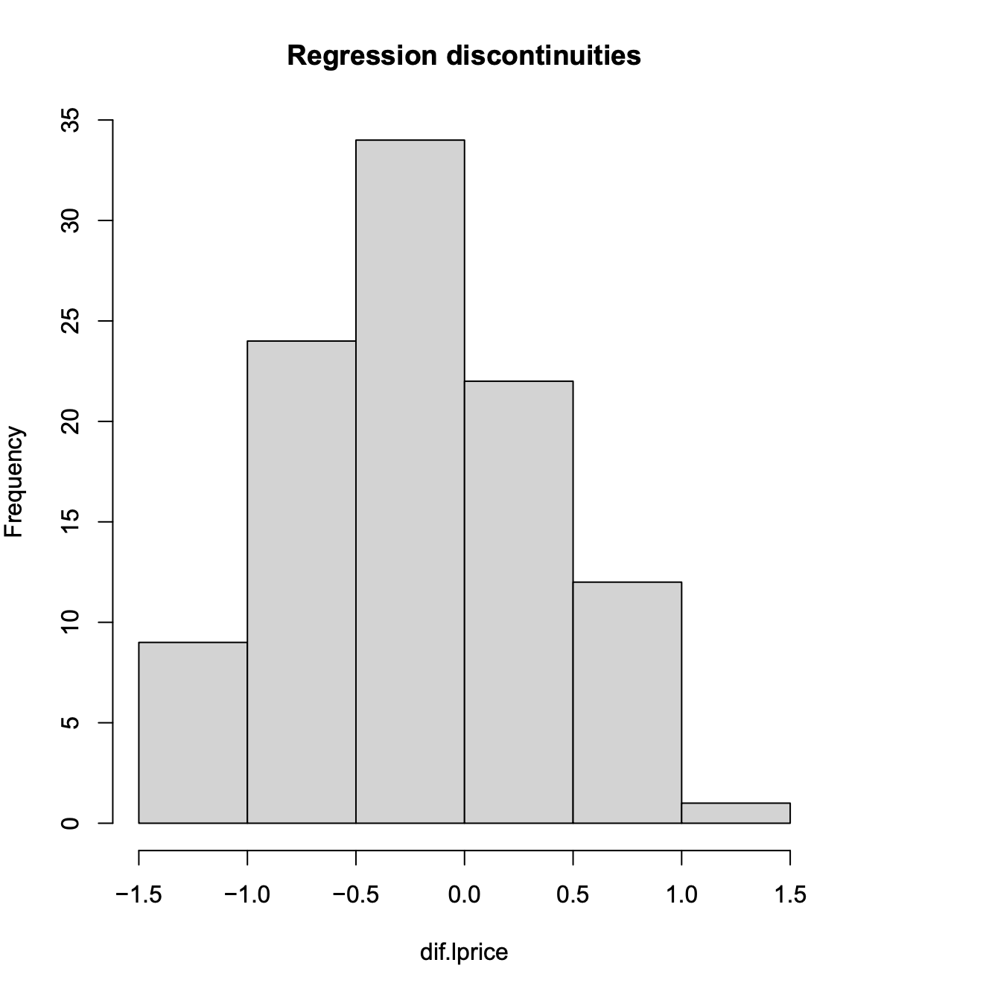
Case Studies: North Carolina
Difference (pre) = -0.1709
Difference (post) = -0.0459
37% significant gradients, no discontinuities, avg. wombling measure = -0.9061. Prices increased by an average of 40% inside the BIP.

Slide 7
BIP Analysis : National Level
297 USDA RUS Awards; 100 had valid arms-length house sales values in the CoreLogic database.
Fitted hierarchical Bayesian spatial regression model for each RUS ID within a 10-mile radius.
Recorded Difference in Difference (DID) estimate for each model, along with its standard deviation.
Performed a regression discontinuity analysis and spatial gradient assessment.
Compared the DID estimates across loan amount and connection type to summarize the analysis
For the sake of brevity, the RD and gradient analysis are not shown
Notes:
The RD and gradient assessment plots for some of the BIPs will be included in the final report.

Slide 8
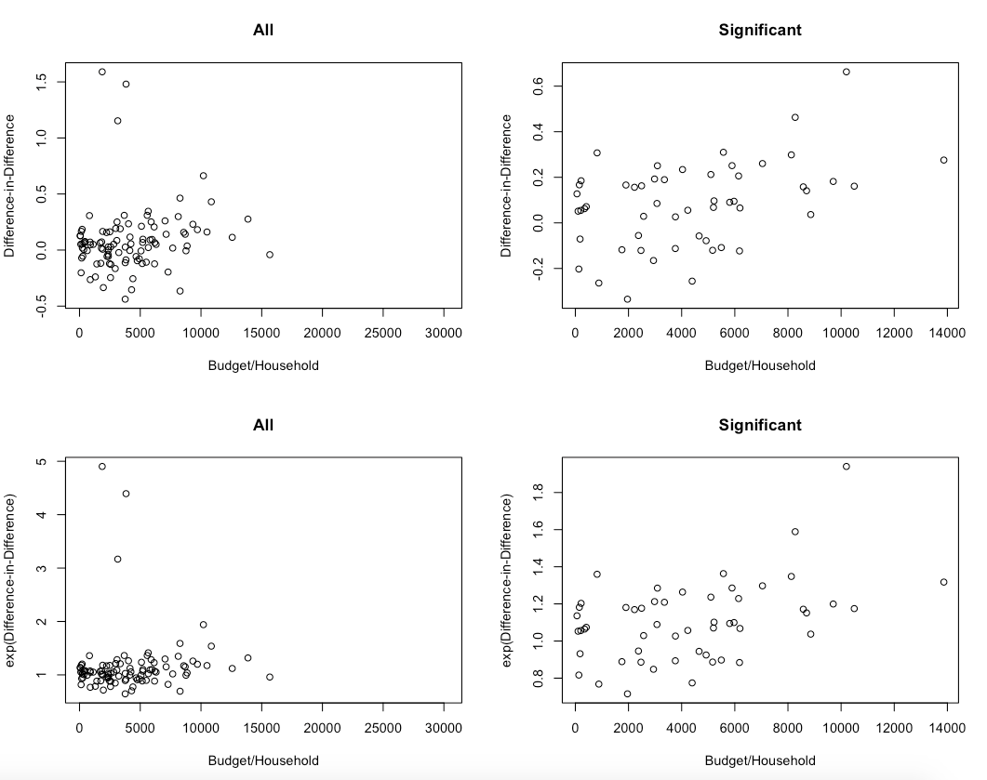
DID Estimates vs Loan amount (Award/HH)

Slide 9
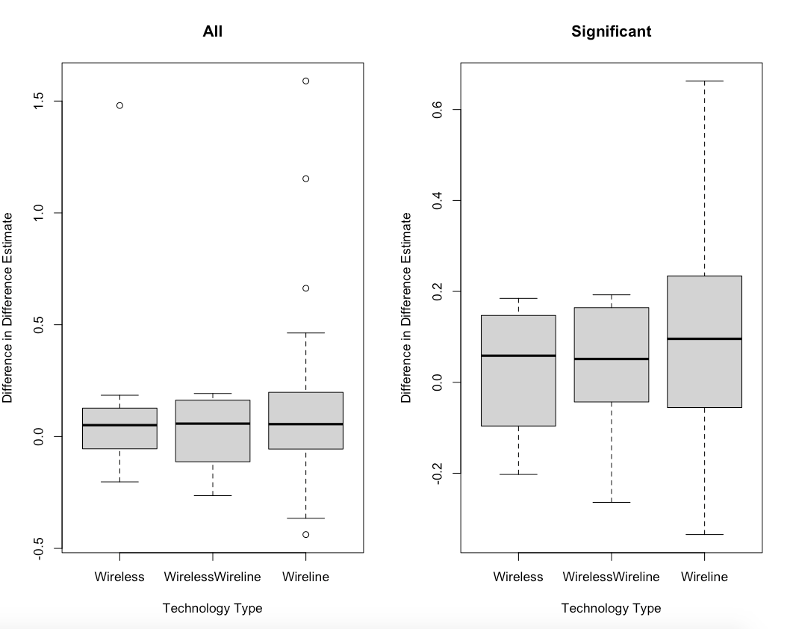
DID Estimates vs Technology Type

Slide 10
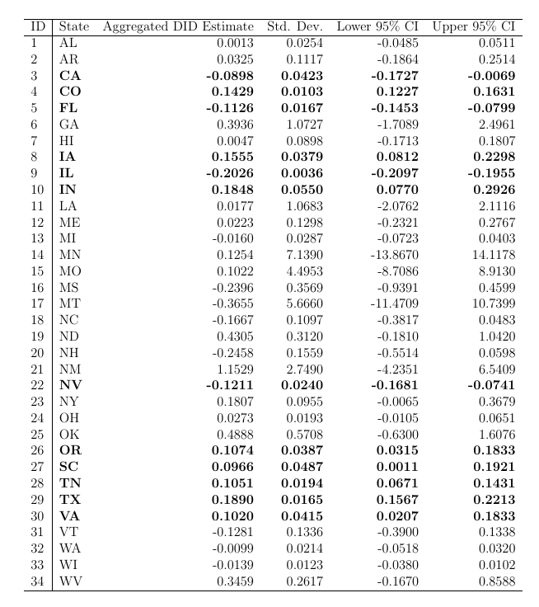
Aggregated DID Estimates: State Level
Aggregated DID estimates at the state level to produce estimates of efficacy at the state level.
Used available CoreLogic arms-length sales in 34 states.
Marked significant estimates (at 95% level) in bold.

Slide 11
Posterior Surface Analysis
Following the model fit (DID estimates shown previously), we proceed with posterior surface analysis using Regression Discontinuity Design and Gradient Assessment.
We record the following summaries (at the line segment level):
Percentage of significant discontinuities/gradients
Difference in log-house prices (inside vs outside the BIP) (before 2010) and (post (2010) to check the continuity assumption for DID
Average discontinuity along the BIP boundary
Average Gradient (Wombling measure) for the BIP boundary for every program area

Slide 12
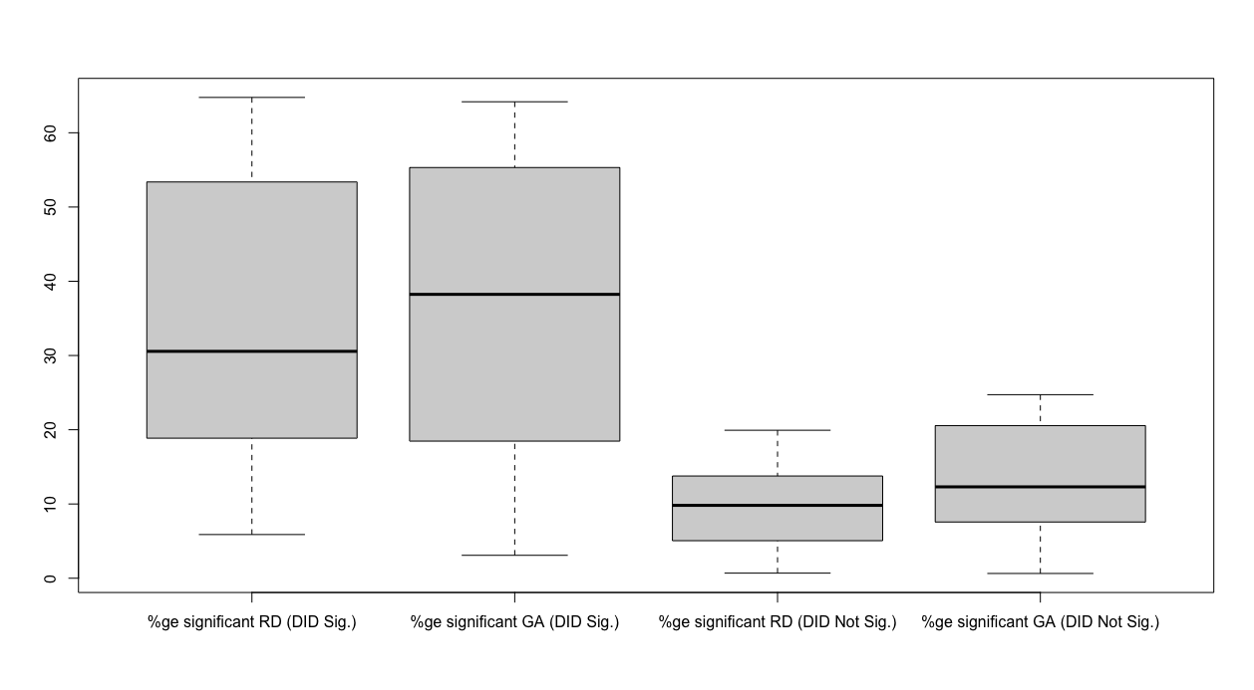
Comparison of Significance
Figure shows the percentage significance if DID is significant

Slide 13
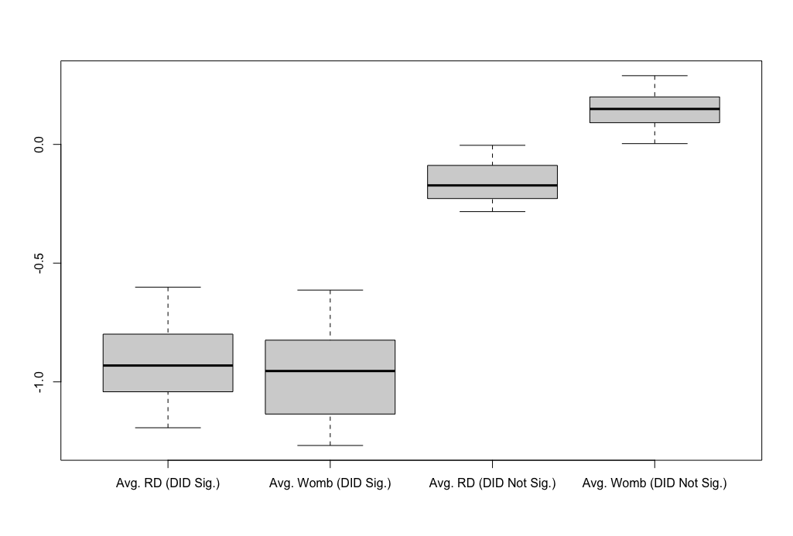
Comparison of Significance
Figure shows the average wombling measure if DID is significant.

Slide 14
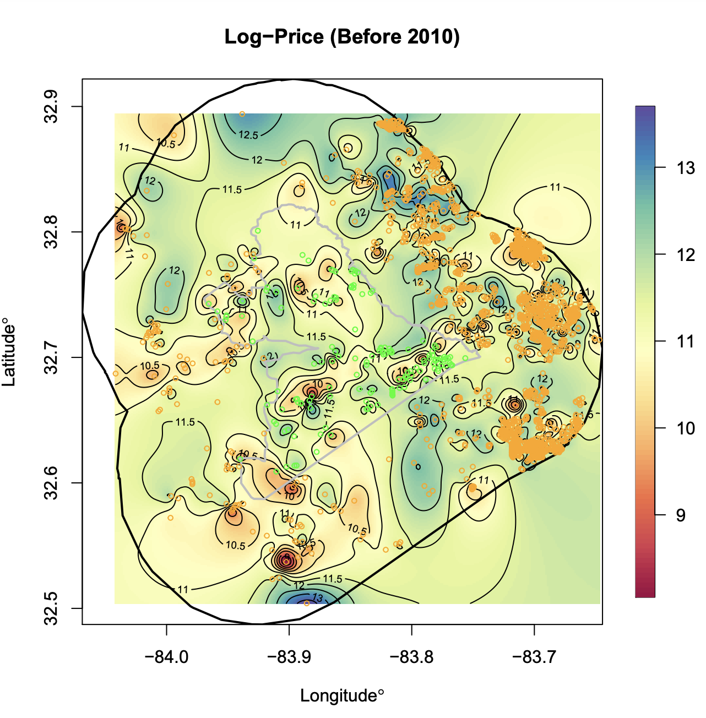
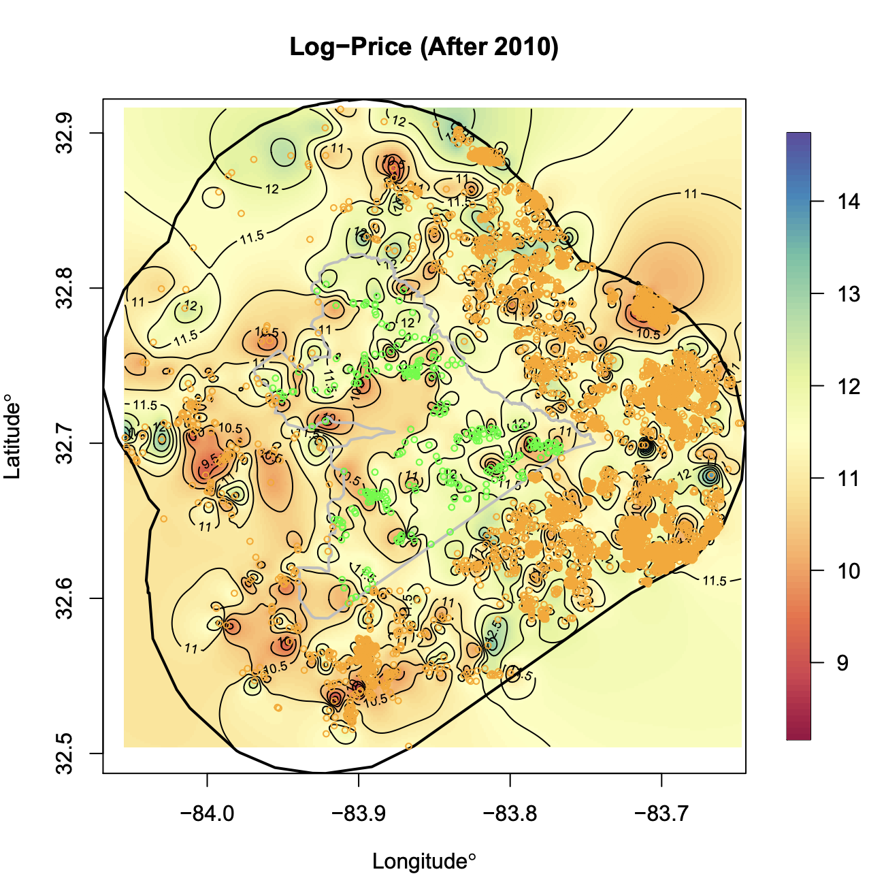
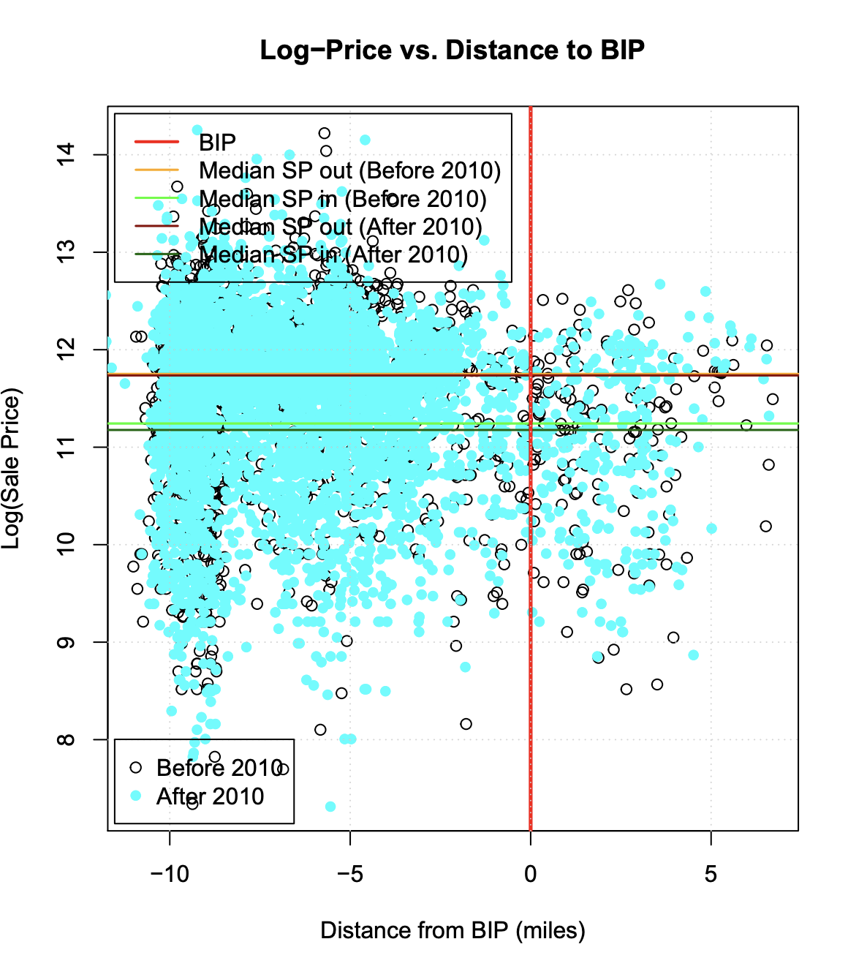
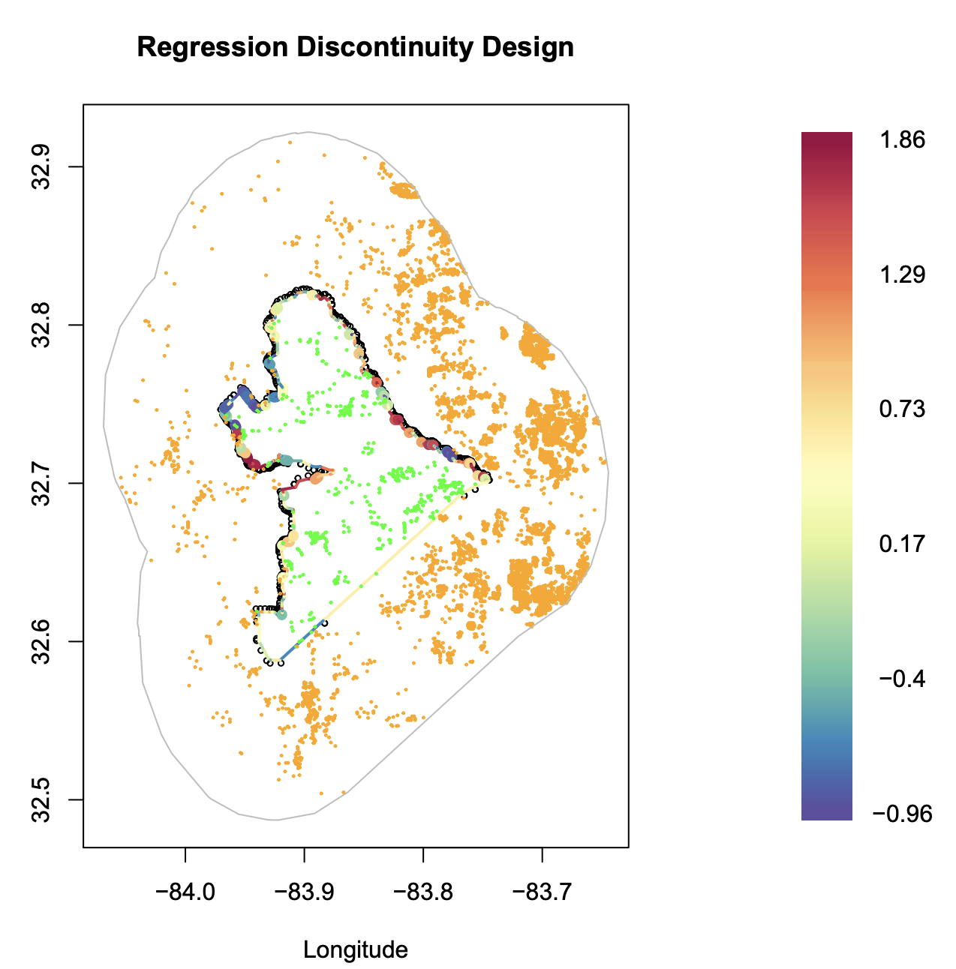
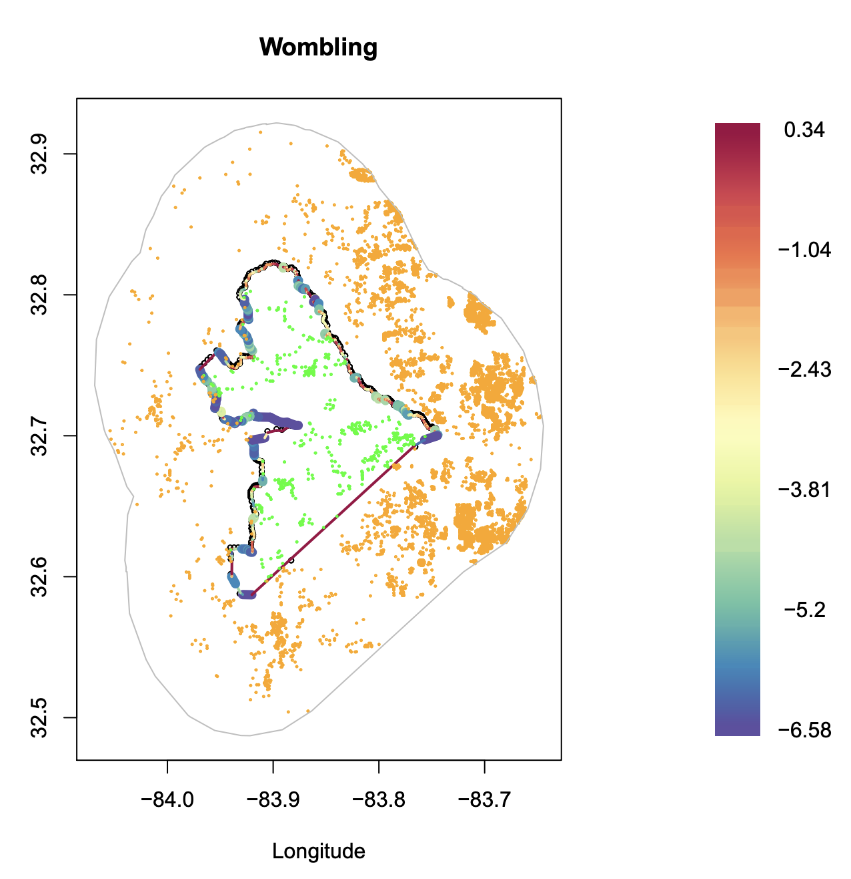
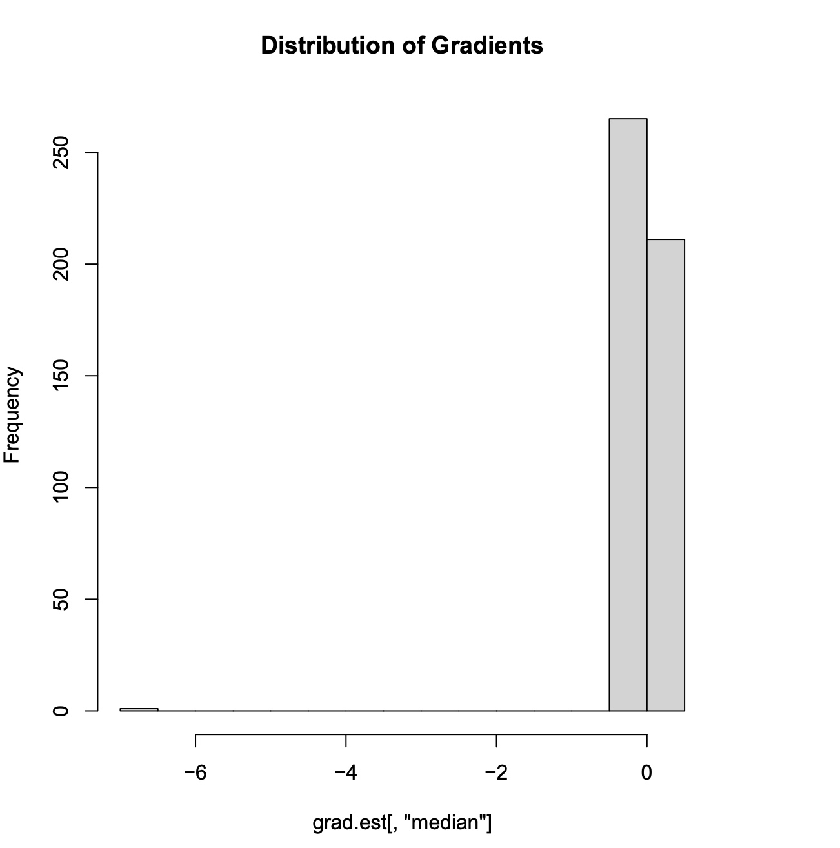
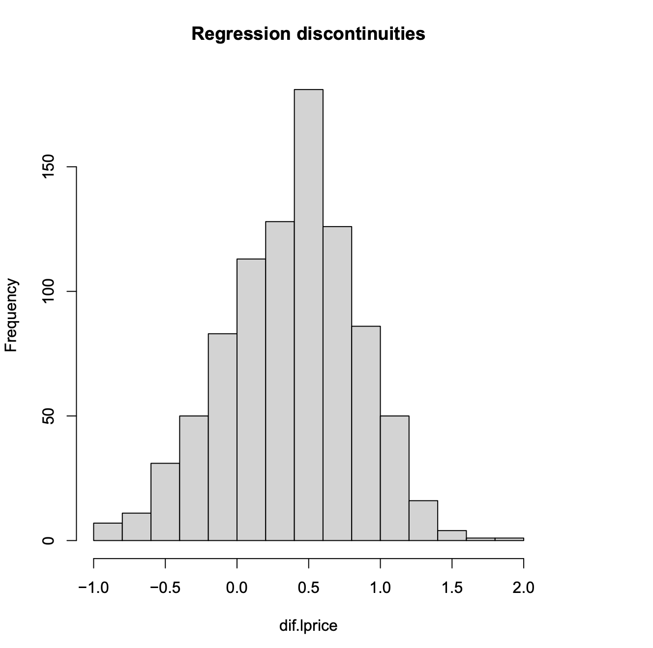
Case Studies: Georgia
Difference (pre) = -0.4781
Difference (post) = 0.4456
25% significant gradients, 7% discontinuities, avg. wombling measure = -7.1089. Prices increased by an average of 0.08% (according to gradients)and 46% (according to the discontinuities) inside the BIP.

Slide 15
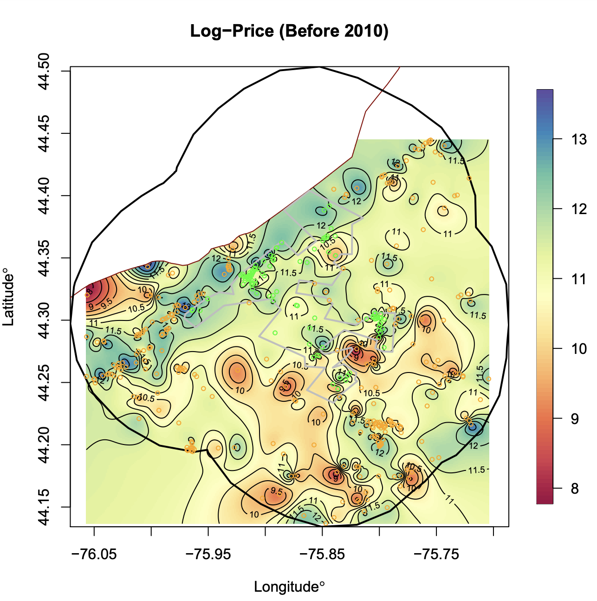
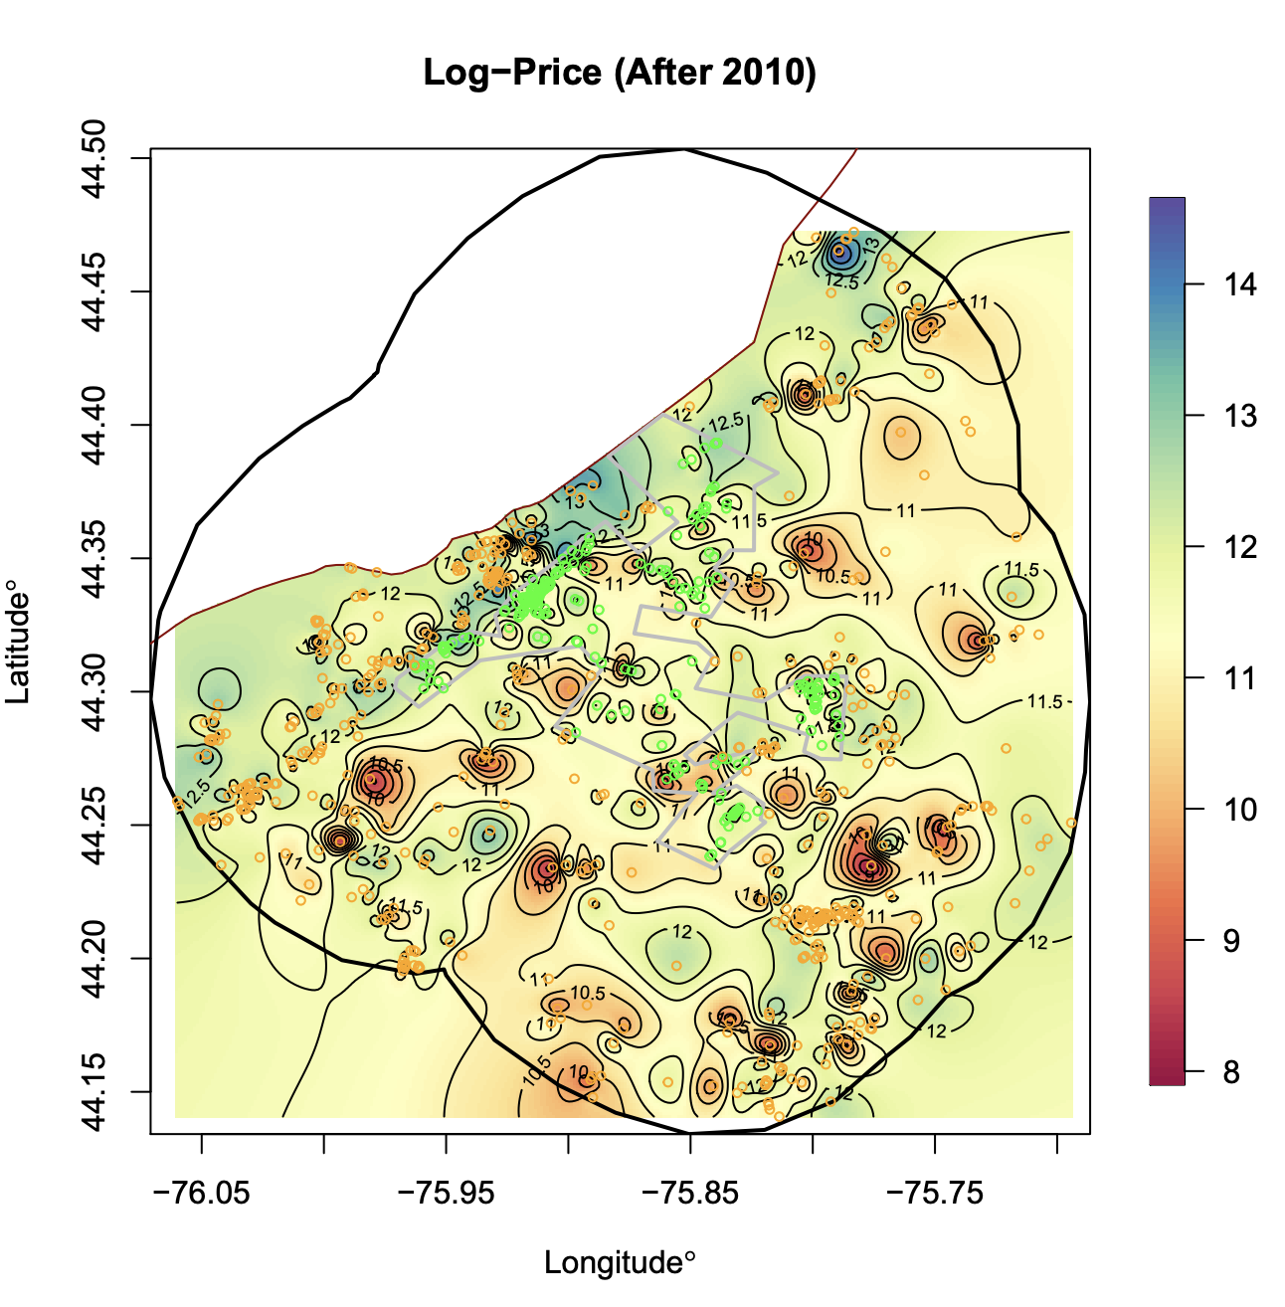
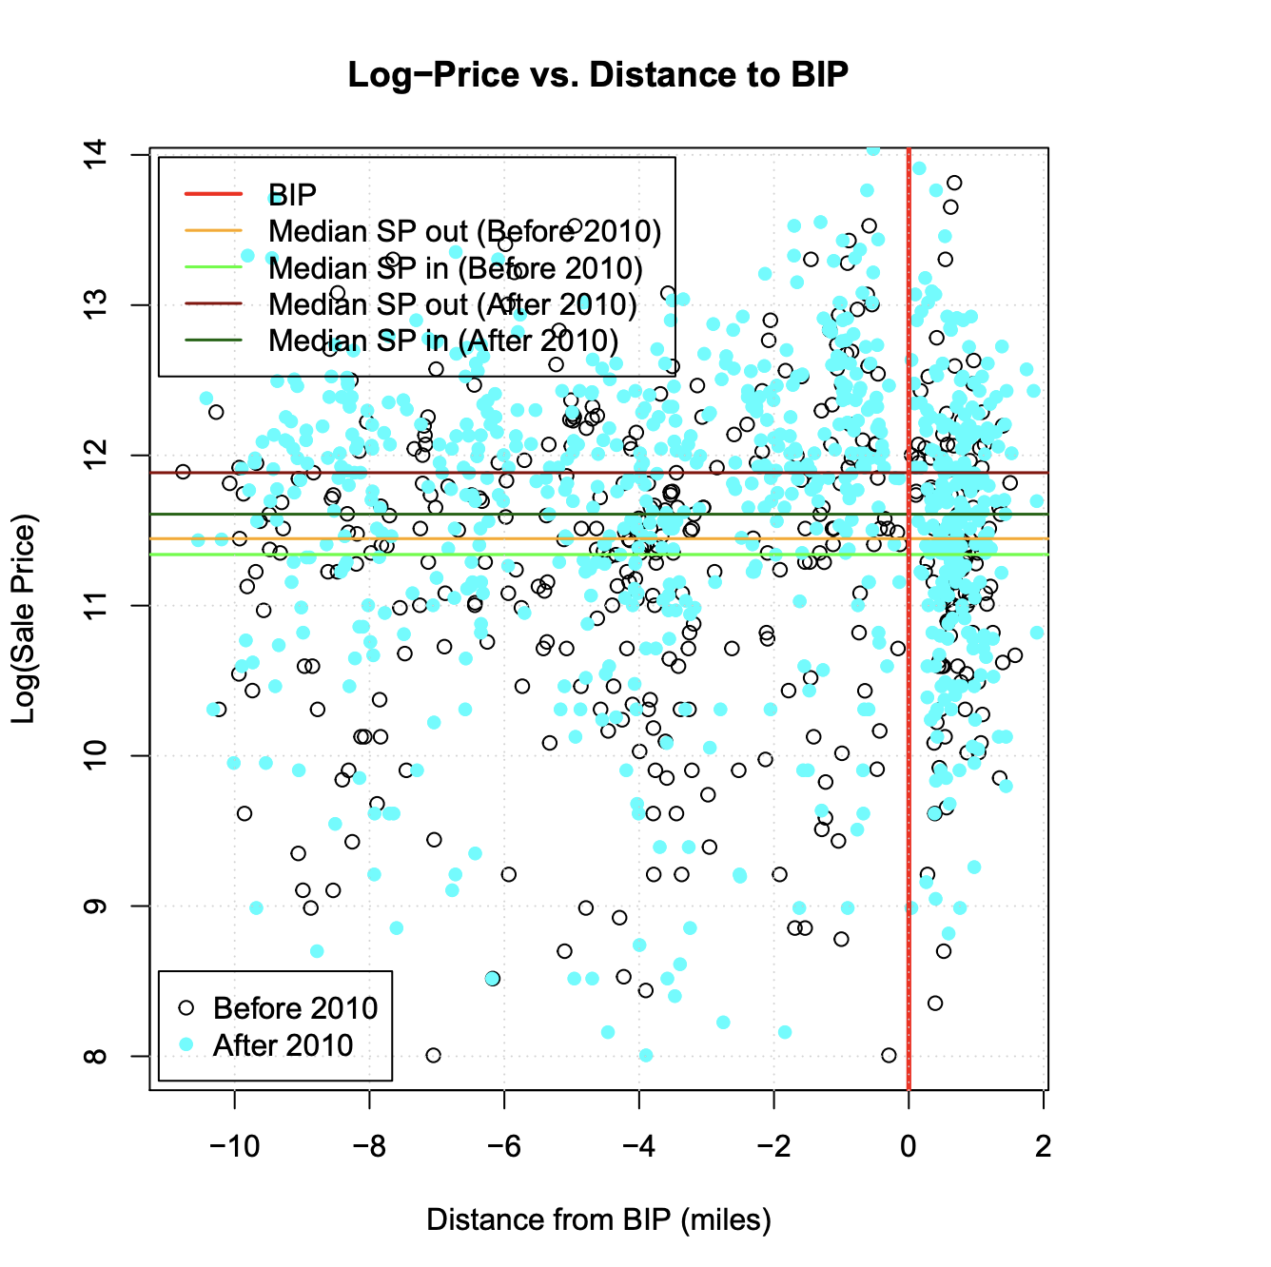
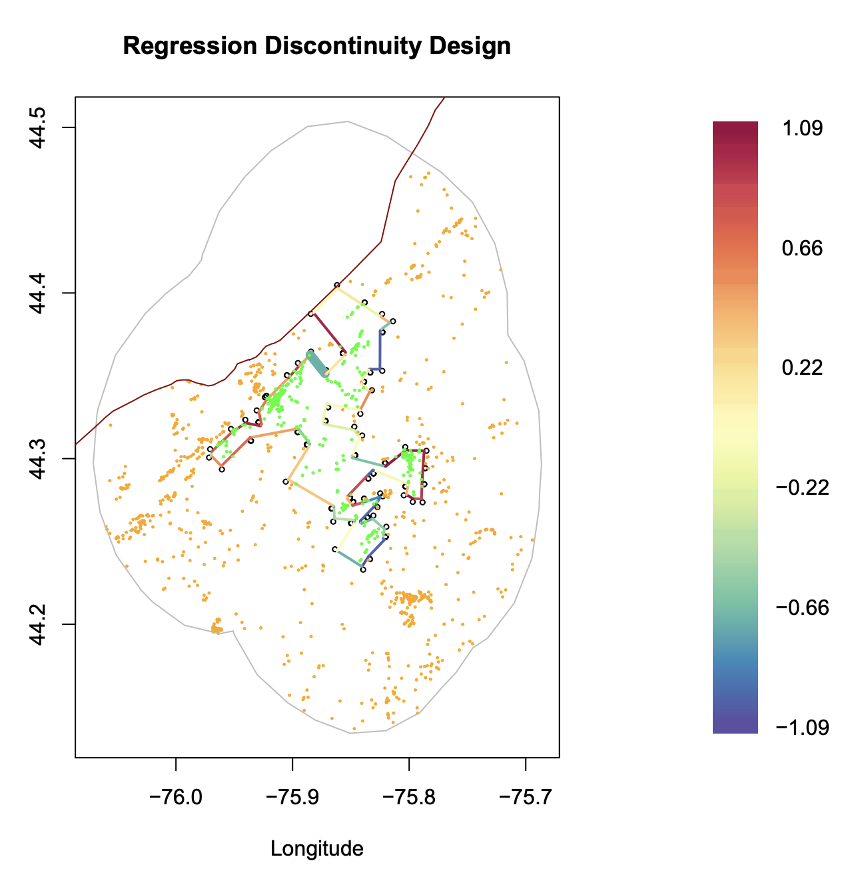
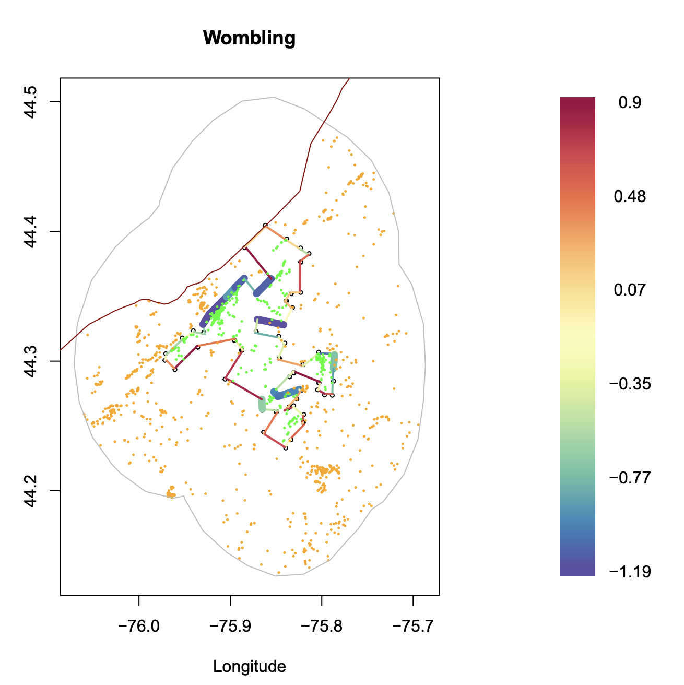
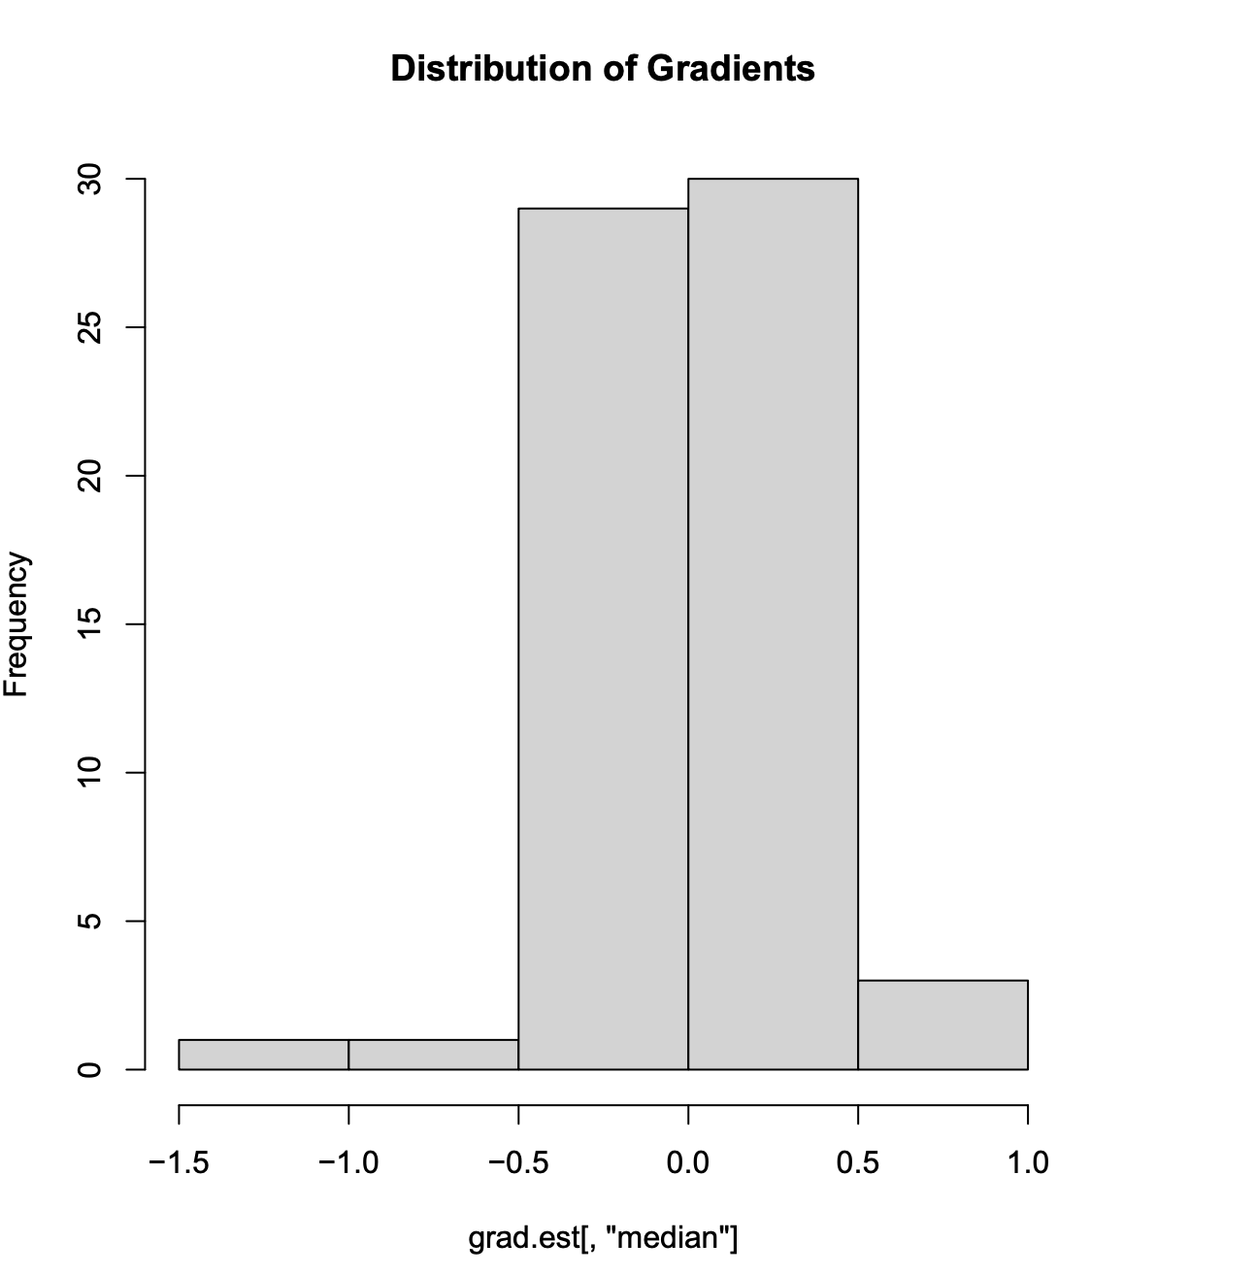
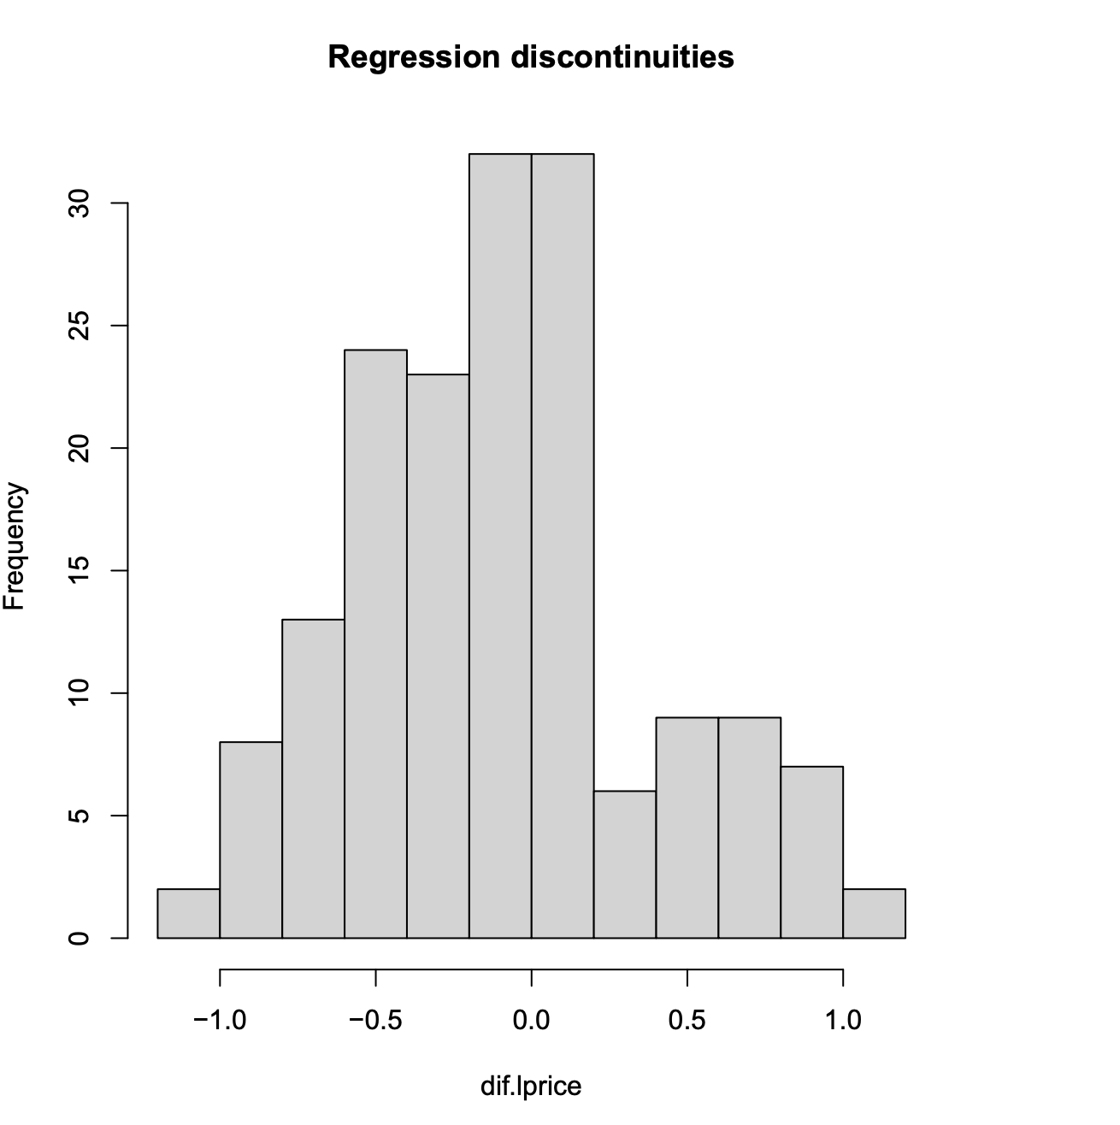
Case Studies: New York
Canada
Canada
Difference (pre) = 0.0170
Difference (post) = -0.1437
20% significant gradients, 6% discontinuities, avg. wombling measure = -0.0925, avg discontinuities=-0.1437. Prices increased by average of 9%, according to gradients &14%, according to discontinuities, inside BIP.

Slide 16
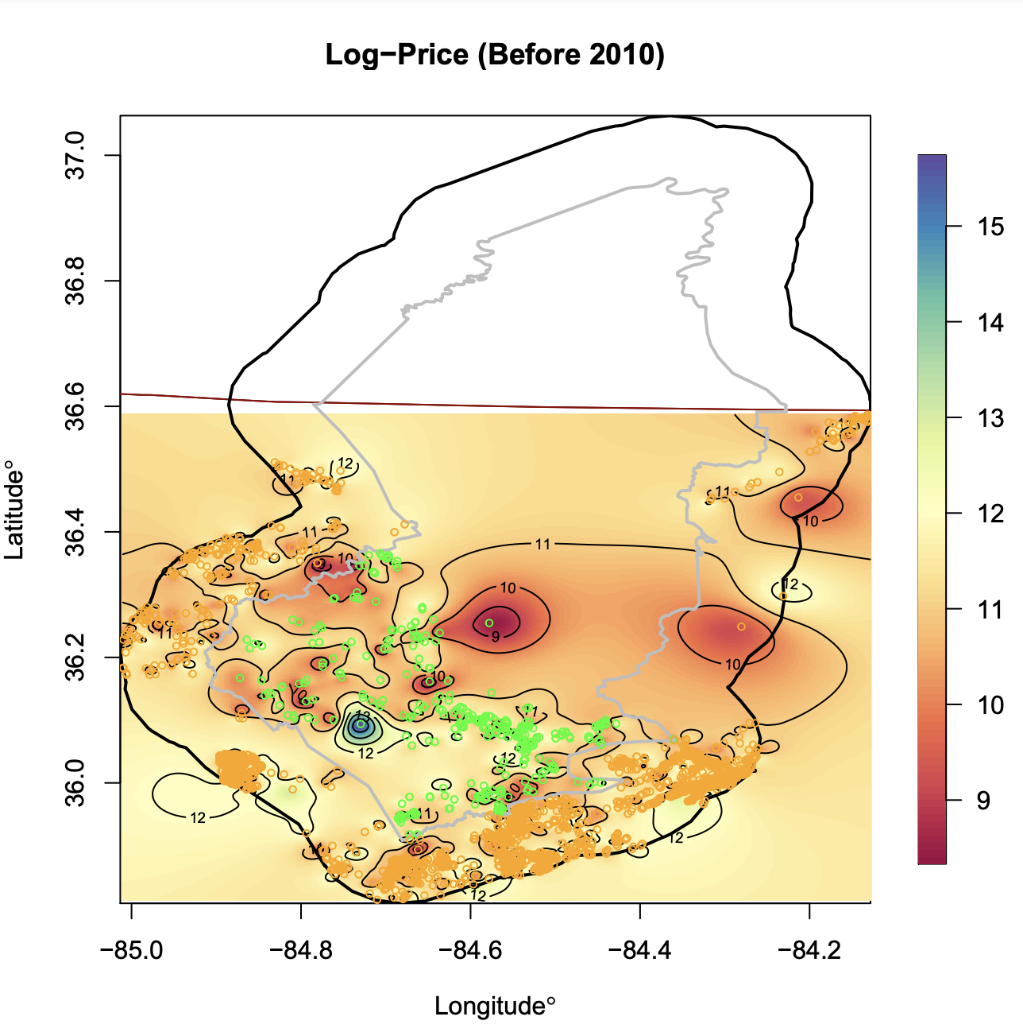
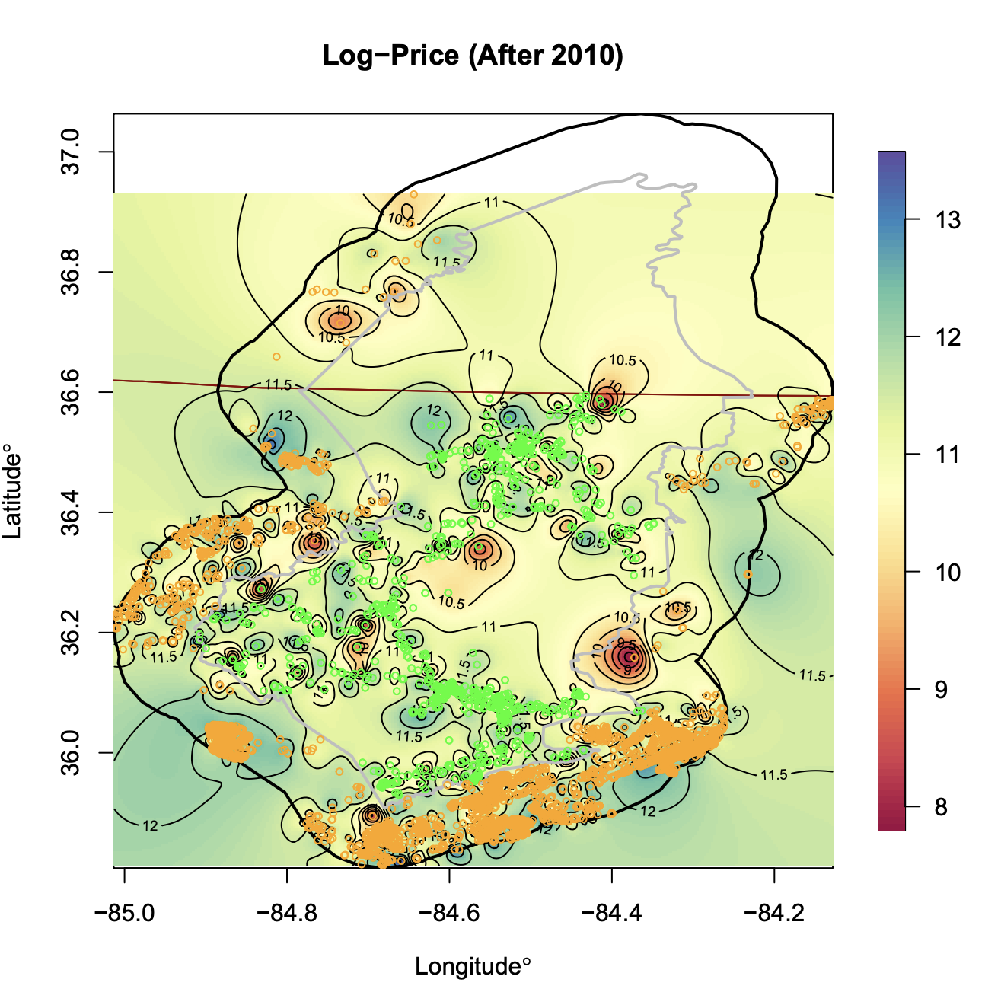
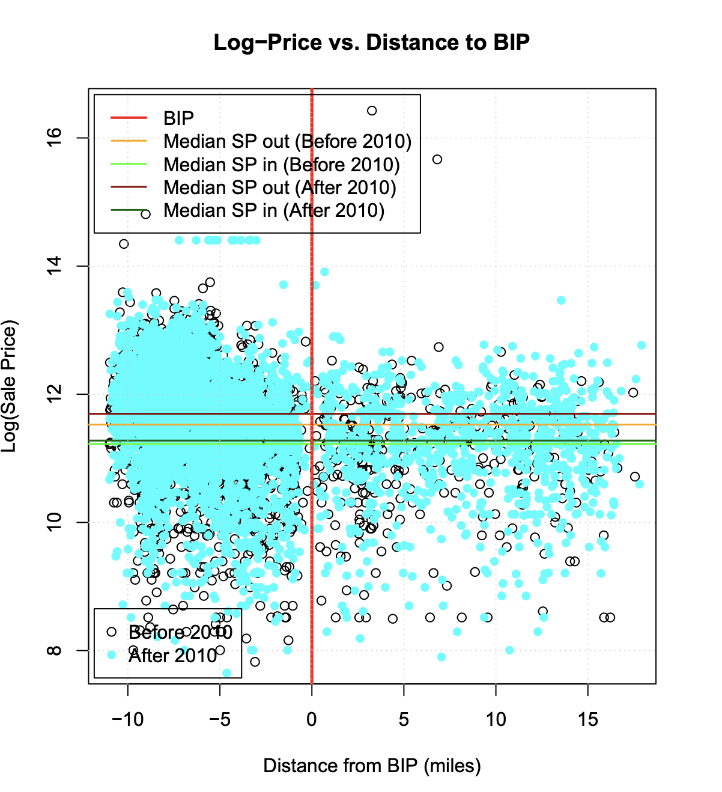
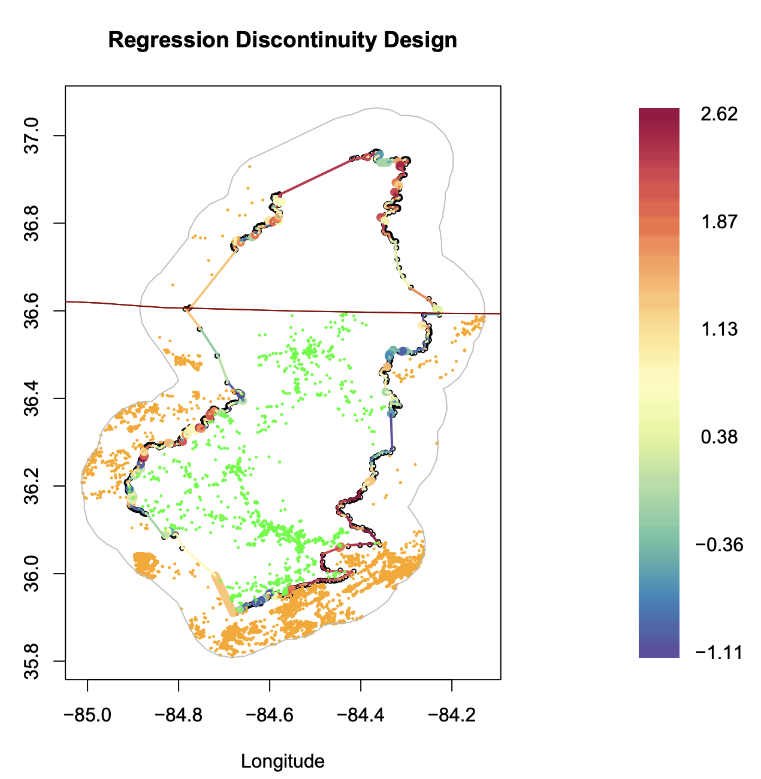
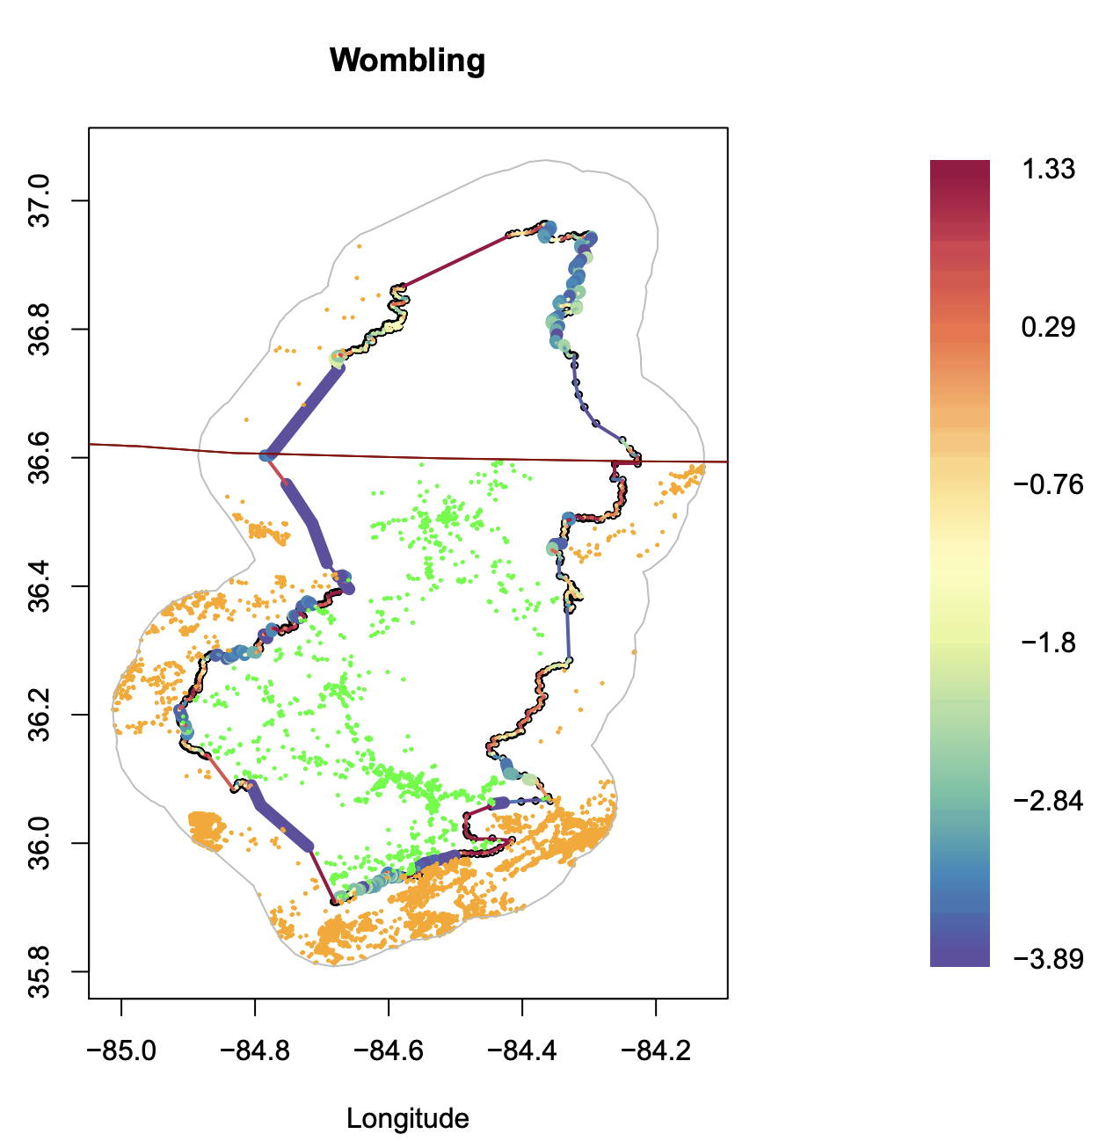
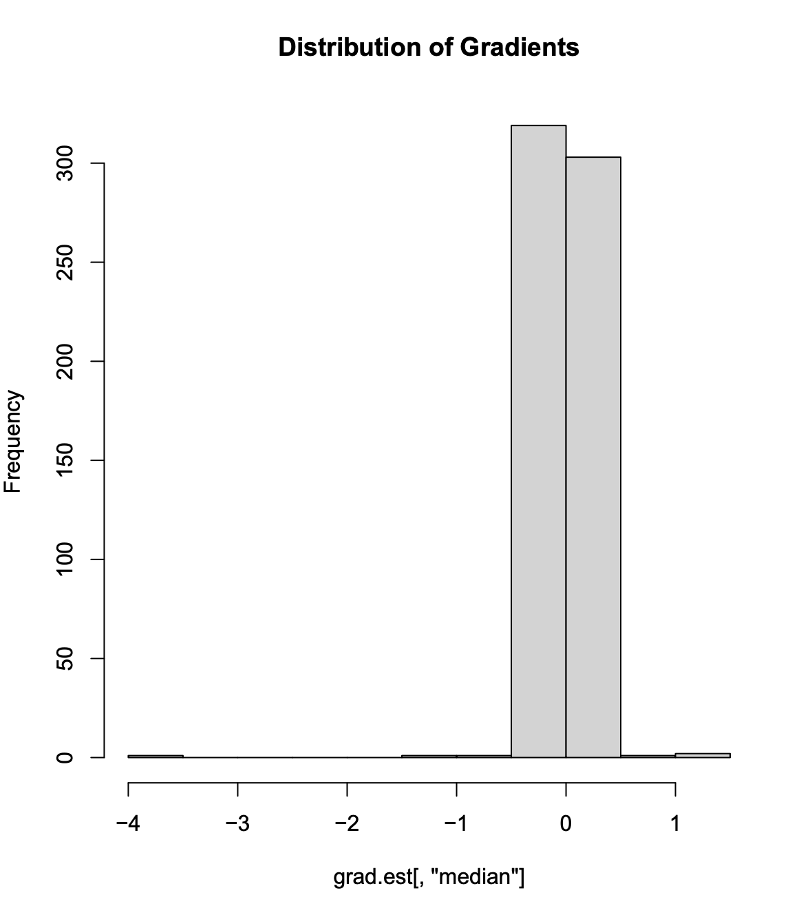
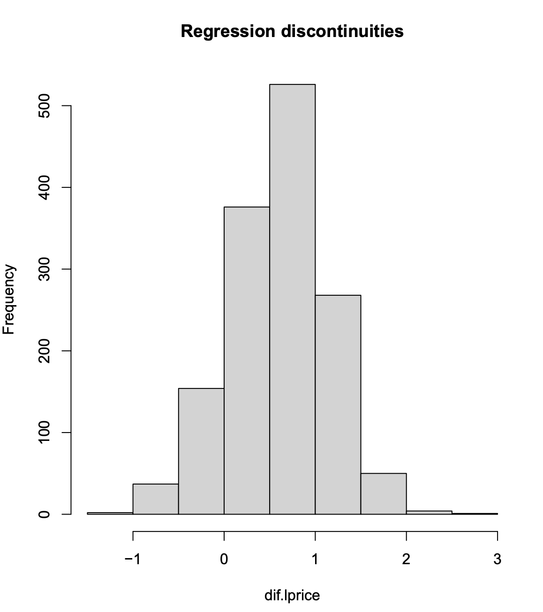
Case Studies: Tennessee
Difference (pre) = -0.4104
Difference (post) = -0.4233
20% significant gradients, 6% discontinuities, avg. wombling measure = -1.2601, avg discontinuities=0.5984. Price difference of 80%.

Slide 17
Conclusions
Produced a framework to evaluate changes in house prices served by BIP.
Used the BIP program as an example:
Framework is applicable for the evaluation of any subsidy program with a spatially indexed response source (in our case, house prices).
Real estate prices are affected by temporal correlation.
Extensions of the proposed setup include time using dynamic spatiotemporal models as a feasible solution.
Inclusion of time facilitates an evolutionary study of the program impacts.

